Slide 1
Dealing with mental health holistically to enhance the international student experience
ISANA Panel Discussion
Thursday 19th November, 2015
Suzanne Dick

Slide 2

General themes for all services
Period of transition
  In 2014 biggest recruitments of international students was from China (27%) and Malaysia (26%)
  next biggest group was South Africa which accounted for 5% of international enrolments
Social isolation (initially?)
Language barriers
Promotion and uptake of services
Pressure from family/ culture to succeed
Financial stress
  Paid in cash
  Discrimination/ harassment
Resourcing
Gender roles
Model of education
  Rote learning vs independent thinking
Visa issues

Slide 3
Unique themes to counselling
Stigma – mental health/ counselling
Limited framework for understanding the counselling process
Ability to provide documentation
Boundaries of the therapeutic relationship
Irregular attendance (?)
Complex (?)
Limited access to public mental health services
Reluctance to access private providers of psychological services
Impact of counselling on the client’s ability to reintegrate into home country

Slide 4
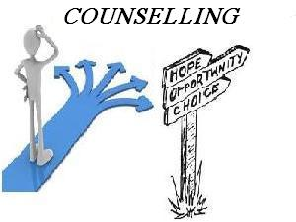
Services offered
1:1 counselling
  3-6 sessions
Groups
  Mindfulness for Academic Success
  Mood Surfing
  SMART
  Brain Management
  Lunchtime mindfulness
External referral

Slide 5
Main considerations for counselling
Building engagement
Orientation to the counselling process
  Not a medical doctor
  What a counsellor does
  How to use the time
  The importance of the client giving feedback
Indicate commitment to helping
  e.g. providing practical support for under loading, special consideration
Attending to the basics (diet, sleep, exercise)
Negotiating clear goals for treatment
  What is possible in the time frame?
  What is the client’s intention (e.g. return home/ stay in Australia)
  Solution focused vs therapeutic work

Slide 6


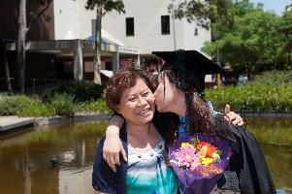
Conclusions
International students
  Remain under-represented as a proportion of total counselling clients
  Often present with more complex needs which create challenges for service provision in an environment of reduced resources
  May require modified approaches to counselling (more orientation, slower pace, more targeted goals etc)
  Benefit from engagement with counselling services

