Slide 1

Engagement with Employers – International Students in WIL Placements

Slide 2
OUTLINE OF PRESENTATION
What are employers looking for?
Barriers to Employment – Students & Industry Perspectives
Jobshop International Internship Program at Deakin University (JIIP)
The Future/Recommendations
Questions

Slide 3
WHAT ARE EMPLOYERS LOOKING FOR?
(as ranked by employers; ranked by proportion of employers who considered each to be an important selection criterion. Source: Graduate Careers Australia)
Interpersonal/
Communication
Drive/Commitment/
Industry knowledge
Analytical skills
Academic results
Cultural/Value alignment
Work experience
Teamwork skills
Emotional intelligence
Leadership skills
Activities (intra and extra curricular)

Slide 4
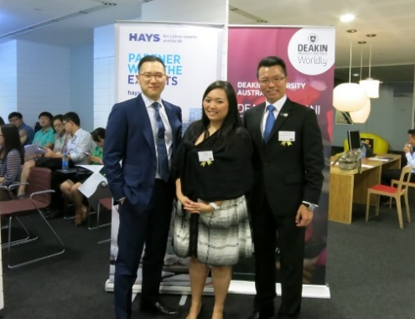
WHAT ARE EMPLOYERS REALLY LOOKING FOR?
Permanent residency status – Confusion over visa status and working rights of international students
Graduates who can stay in a job longer than 2 years
Graduates who can speak and write English fluently
“Cultural” fit

Slide 5

BARRIERS TO EMPLOYMENT FOR INTERNATIONAL STUDENTS – AUSTRALIA
Visa issues
English language skills
Australian workplace culture adjustment
Unrealistic job expectations
Lack of networks
Confidence levels in approaching employers

Slide 6
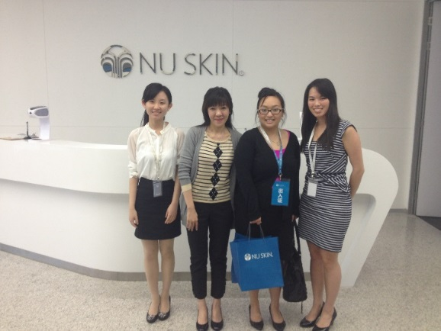
BARRIERS TO EMPLOYMENT FOR INTERNATIONAL STUDENTS – OVERSEAS
Unrealistic salary expectations
English language skills
Unrealistic job expectations
Reverse culture shock
Lack of understanding of “local "issues

Slide 7


QUOTES FROM INTERNATIONAL STUDENTS
“I started searching for internships in my last Trimester and expected Deakin to help me find industry based internships but realised they don’t”
“It would be great if Deakin could provide international students paid internships”
“Please provide more job opportunities for international students as most of them are only for domestic students”
“We need a chance to talk to employers and find out what they require”
“Facilitating Australian work experience for internationals would be great”

Slide 8

RIGHT, LET’S DO SOMETHING
Investigated Non-Profit Sector
Creation of exclusive Internship Program (JIIP)
Research:
Contacted 300 NFP’s
Conducted structured interviews around the concept of WIL and IS
Ascertained: level of interest, challenges, issues, typical projects and overall feasibility

Slide 9
THE NEW INITIATIVE (V1)
JULY
Stakeholder discussions and marketing
AUGUST
Marketing to hosts and students apply
SEPTEMBER
Recruitment process
OCTOBER
Host interviews
NOVEMBER
Students commence /Pre Placement Session
DECEMBER
Site visits and ‘Social Day’
JAN/FEB
Post Placement Session

Slide 10





WHAT’S IN A NAME?
IPIS
ISIS
JIIP

Slide 11


IMPLEMENTATION V1 - EMPLOYERS
Resources: marketing collateral, project templates
Follow up: phone calls to interested employers
Strategy: collaboration with Local Government

Slide 12


IMPLEMENTATION V1 - STUDENTS
BEFORE:
Promotion
Check eligibility
Shortlist
Interviews
Pre Placement Workshop
DURING:
Ongoing support
Site visit
‘Social Day’
AFTER:
Post Placement Workshop
Award Ceremony – high profile

Slide 13



IMPLEMENTATION V2
Streamlined process
Increased placements from 20 to 65
Inclusion of IT students
Internal and external recognition
Problem solving
Victorian International Education Award
Vice Chancellor’s Award
Award Ceremony for Interns

Slide 14

BENEFITS AND OUTCOMES
Very popular – repeat business
Career development learning
Good example of WIL
Identified new market of hosts
Increased host database
Increased employability

Slide 15

LEARNINGS
Importance in Relationships
Confidence in international students is a MAJOR barrier to employment
Employers need more education about visas/benefits of international students
Collaborative approach needed

Slide 16
THE FUTURE (2016 AND BEYOND)
Practice
Policy
Support
Government Support is crucial in supporting international employment initiatives
Further Education required to educate employers about international students – dispel the myths
Further support and funding required to support and prepare International students for the local and overseas workforce.
Continuous benchmark and support from within the sector
Importance of WIL to be emphasised to students

Slide 17
SANKET’S INTERNSHIP JOURNEY

Slide 18


THANK YOU & QUESTIONS?
Grace Diep
Team Leader, Enterprise Relations and Work Integrated Learning
RMIT University – College of Business
E: grace.diep@rmit.edu.au

