Slide 1

Self-care for Student Support Staff
Dr Megan Brownlie
Psychologist, Monash College
ISANA Vic/Tas Conference
9th September 2016

Slide 2

Agenda
What is self-care?
Common traps
Work-life balance in Australia
Consequences of poor self-care
Model of self-care
Self-care assessment
Strategies for self-care
  Macro
  Micro
  Mindfulness
Notes:
Support service workers self-select into caring roles because we want to help others.
But it’s stressful work.
Recipe for compassion fatigue: Meeting others’ needs but neglecting our own
Stress-related symptoms and job dissatisfaction leads to decreased productivity and high rates of attrition within the helping professions (high costs of not addressing self-care to the individuals and the organisations that we work for, including the students we seek to help).
Metaphor: the Lifesaver – they can’t save a drowning person if they don’t know how to swim.

Slide 3

Definition: Self-care
(Lombardo & Eyre, 2011)
The practices or rituals we use to:
reduce stress
cope with the challenges of work
enhance subjective sense of well-being
replenish energy levels

Slide 4

Quick quiz

Slide 5


Australian Work-Life Balance (WLB)
WLB ranked most important aspect of life (OECD Better Life Index)
42% WLB deteriorated over 5 years (Baker, et al., 2014)
20% too busy for lunch breaks (Cameron & Denniss, 2013)
Notes:
Research shows these behaviours are common.
And that our behaviour falls well short of our national aspirations for a work-life balance.
OECD Organisation for Economic Cooperation and Development – maps international levels of well-being
= over 7000 respondents, equal number of females and males
= what issues matter most to people

Slide 6

Work-Life Balance research
Johnson (2015), The Australian Institute
54% did unpaid overtime in previous week
Almost 50% felt over-worked
50% failed to take full annual leave
The negative impacts of unpaid overtime
  Stress 38%
  Time for exercise 67%
  Time with friends 67%
  Time for cooking 62%
  Sleep 33%

Slide 7
Work-Life Balance - Conclusions
The effects of smart technology
  extends the working day
  blurs boundaries (work/home)
  work “bleeds” into personal life
  serious impacts on health & well-being
  self-care is more important now than ever

Slide 8
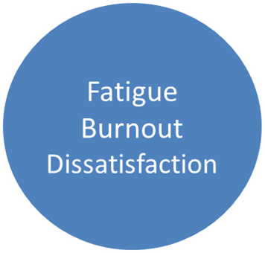
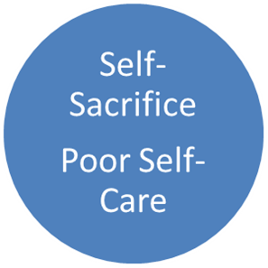

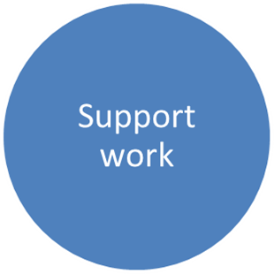
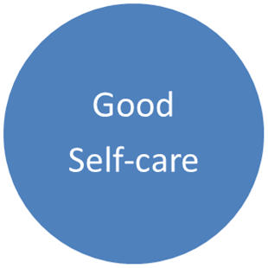

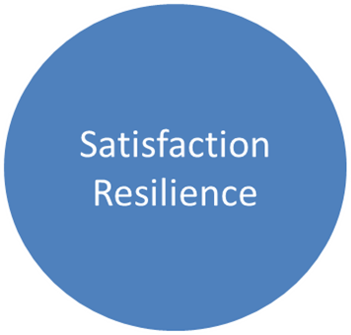
The importance of Self-Care
Notes:
People in the support services sector self-select into caring roles because we want to help others.
But it’s stressful work.
Recipe for compassion fatigue and Burnout: Meeting others’ needs but neglecting our own
Metaphors
the Lifesaver – you can’t save a drowning person if they don’t know how to swim
Self as an instrument – we need to keep ourselves ‘well tuned’ so we can help others
The difference between the 2 trajectories is how REACTIVE vs PROACTIVE you are in addressing the stresses of your work and ability to achieve work-life balance.

Slide 9

Compassion fatigue
“The combination of physical, emotional, and spiritual depletion associated with caring for people in … distress” (Figley, 1995)
Metaphor – the saturated sponge
Notes:
The cost of being caring , empathic, compassionate
Talk to the hand! – I don’t care
The saturated sponge can not absorb any more liquid – the helper can’t feel compassion

Slide 10
Compassion Fatigue Symptoms
Lombardo & Eyre (2011)
Work
work dread or avoidance
lack of enjoyment
Emotional
irritability
anxiety
Physical
headaches
lower empathy
absenteeism
oversensitive
restless
substance use
resentment
poor judgement and concentration
gastro issues
insomnia
fatigue
cardiac issues
muscle tension
Notes:
Lombardo & Eyre, 2011 (compassion fatigue in nurses)

Slide 11
Professional Burnout
Disengagement and withdrawal responses
Results from chronic neglect, self-sacrifice
  Emotional exhaustion
  Depersonalisation (reduced empathy)
  Reduced sense of accomplishment
Losing your passion, vision and purpose
Notes:
Symptoms: minimising our students’ negative experiences
preoccupation with their distressing events
loss of purpose or meaning in work
mental and physical fatigue
increase in physical illness and sick leave (avoidance, dread of work)
isolation and withdrawal from others
poor coping strategies to cope with negative feelings (e.g., alcohol or eating behaviours)
decreased concentration

Slide 12
Causes of Professional Burnout
Excessive workload
Little control/autonomy in role
Failure to maintain boundaries with others
Perfectionism (personality)
Poor self-care

Slide 13
Multi-dimensional Self-Care Model
Emotions
Work
Relation-ships
Spirit
Self care
Body
Mind
Notes:
Comprehensive model = Maintaining and enhancing well-being in all the domains of life
Emotional – permission to have and express emotions Spiritual Needs: Engaging in activities that bring meaning to your life
feeling heard and understood Religious
debriefing after challenging incidents Nature or the Environment
doing things that bring you joy or energise you Volunteerism or helping others
Body - physical health Relationships: healthy, supportive, nurturing
sleep friends, family
nutrition clubs, professional organisations
exercise networking like you’re doing today!
taking sick leave
Mind - taking care of your psychological health Work: manageable workload
managing stress support from supervisors/managers/colleagues
personal development breaks from work
helpful self-talk meaningful and satisfying tasks
professional development

Slide 14
Multi-dimensional self-care
Body: diet, exercise, sleep, GP visits
Emotional: expression, debriefing incidents, activity that bring joy or energises
Mind: stress management, personal development, mastering new skills
Relationships: friends, family, clubs, professional organisations, networking
Notes:
Aims of Self-care
Replenishing each aspect of well-being
Relationships – sustaining healthy relationships, (friends, family, clubs, professional organisations, volunteering), meeting new people
Work – manageable workload, support from supervisors/managers/colleagues, breaks from work, meaningful and satisfying tasks, professional development
Mind – taking care of your psychological health, managing and reducing stress, personal development, helpful self-talk

Slide 15

Multi-dimensional self-care (2)
Work
  Manageable workload
  Support from peers, supervisors, managers
  Breaks from work
  Meaningful, satisfying tasks
  Professional development
Spiritual: meaning in life
  Religious, nature, environment
  Helping, volunteerism

Slide 16
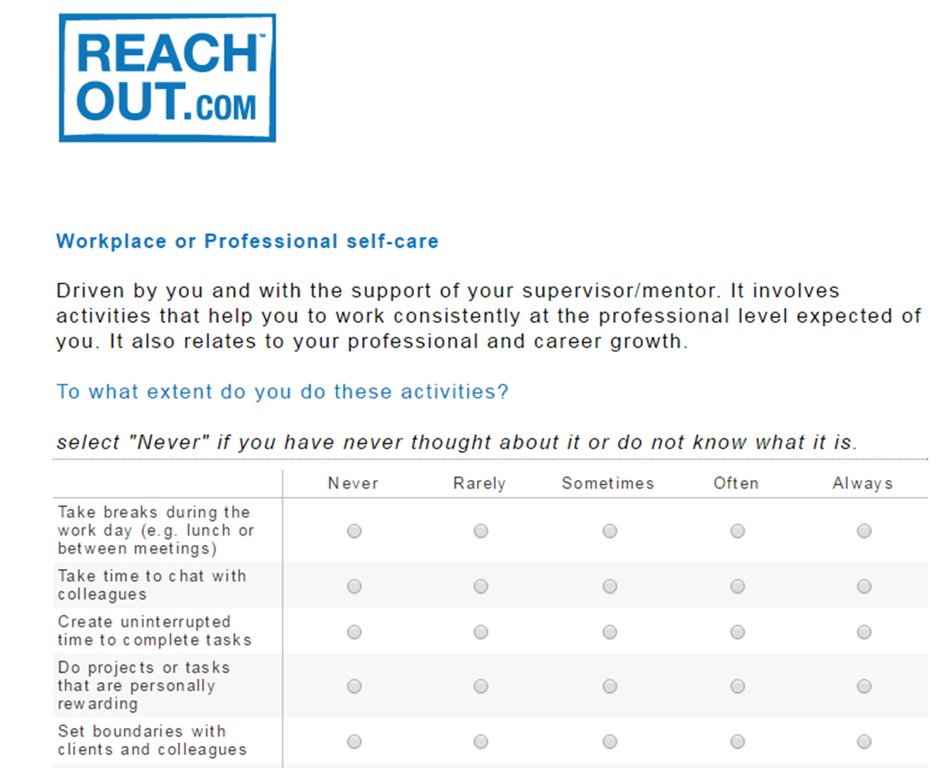
Assess self-care practice
Notes:
Example items: To what extent do you do these activities (rated from Never to Always)
Set boundaries with colleagues and clients/students
Take time to chat with colleagues

Slide 17

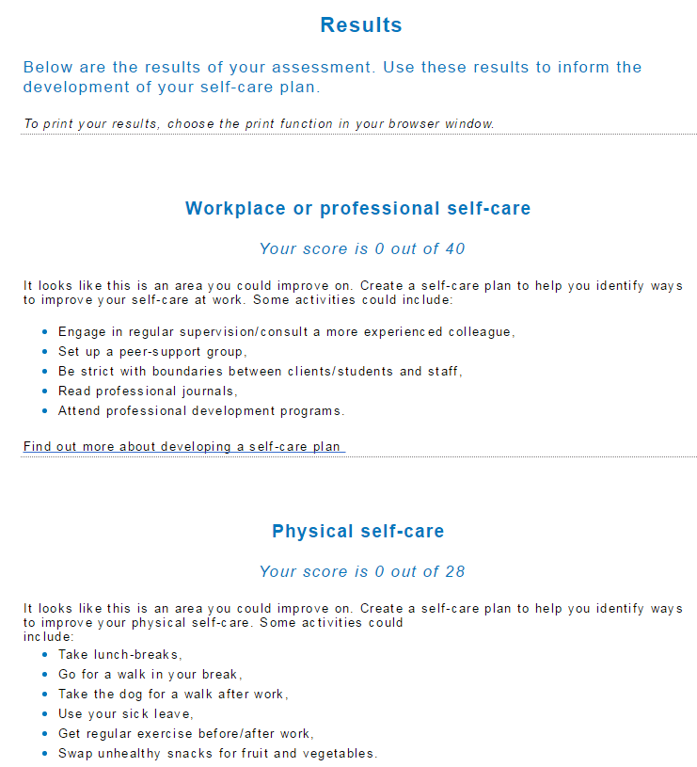
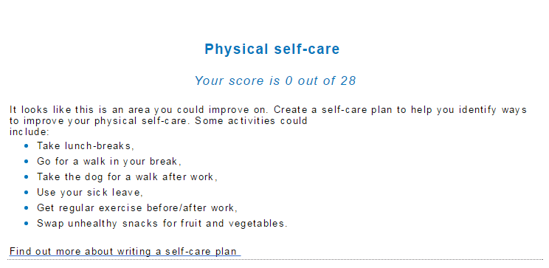
REACH OUT Self-Care Assessment
Notes:
Examples – physical self-care
Take lunch-breaks
Use your sick leave

Slide 18
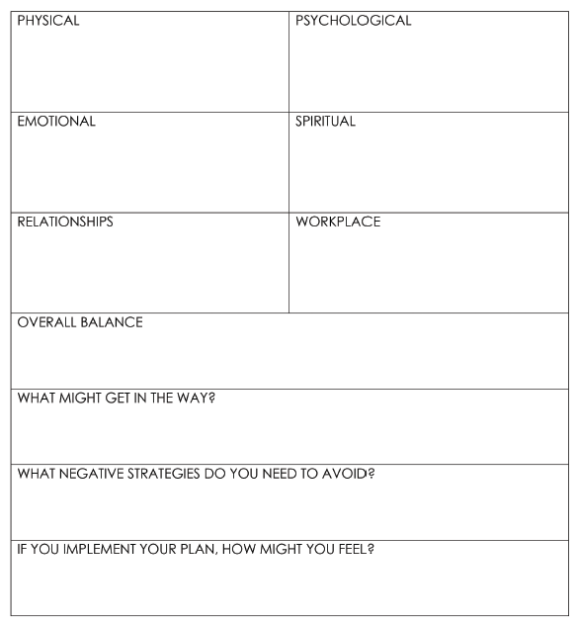
Self-Care Plan

Slide 19
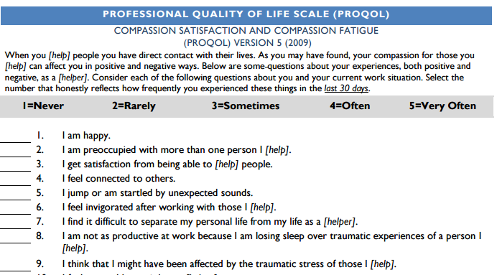
Professional Quality of Life Scale
(Stamm, 2009)
Notes:
Assesses your level of:
Compassion fatigue
Work satisfaction – how much you enjoy and feel effective in your helping role
- Burnout - Feeling hopeless, ineffective, unsupported at work
Secondary traumatic stress = experienced as a consequence of your exposure to others’ traumatic events
Example items:
I find it difficult to separate my personal life from my life as a helper
I feel invigorated after working with those I help

Slide 20
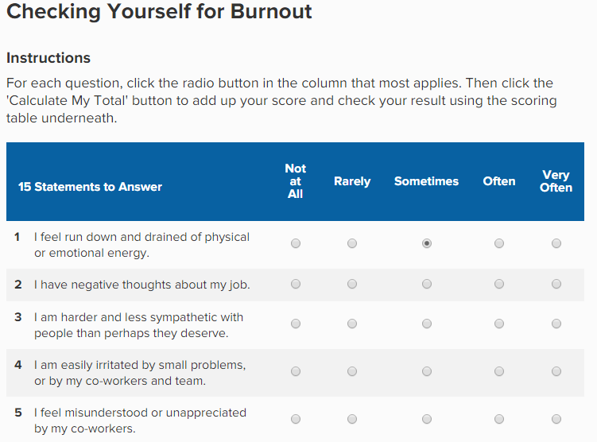
MindTools Burnout Assessment
Notes:
Example items
I have negative thoughts about my job
I feel fun down and drained of physical or emotional energy

Slide 21










Macro Self- care
Bush (2015)
Notes:
taking holidays
physical exercise
good nutrition and sleep
maintaining supportive relationships
developing hobbies
actively relaxing

Slide 22
Micro Self-Care
(Bush 2015)
Bite-sized self-care strategies to weave throughout the working day to:
  Revive, energise, refresh
  Ground, centre
  Be present, attuned, body-mind awareness

Slide 23
Micro-Strategies at Work
(Bush 2015)
Mindful cuppa (to relax, rejuvenate)
    Using all 5 senses
Swinging shirt sleeves (to energise, shift awareness away from internal experience)
    Stand up, swing body, let arms fly loose
Work Gratitude (to counter negativity bias)
  List 3 things you did well today
Notes:
Mindful cuppa:
Feeling of cup in the hand
Sight – froth, bubbles, colour
Aroma
Taste
Sound - drinking, swallowing, breathing

Slide 24

Mindfulness
Focussed awareness
Being present, in the moment
Regular practice (macro)
Brief exercises at work (micro)
  Belly-as-balloon breathing
  Feet on the floor
  Body scan

Slide 25
Summary
Self-care needs to be:
  Proactive and preventative (not reactive)
  Focussed on well-being
  Practiced at Macro and Micro levels

Slide 26
References
Figley, C.R. (1995). Compassion fatigue: Coping with secondary traumatic stress disorder in those who treat the traumatized. New York: Brunner-Mazel.
Lombardo, B., Eyre, C., (Jan 31, 2011) "Compassion Fatigue: A Nurse’s Primer" OJIN: The Online Journal of Issues in Nursing Vol. 16, No. 1, Manuscript 3.
Bush, A. D. (2015). Simple self-care for therapists. New York, Norton & Company.

Slide 27

Tools for Self-Care
Assess Self-Care (ReachOUT) https://inspire.au1.qualtrics.com/SE/?SID=SV_8vN4sBPKXhoVpv7
Assess Compassion Fatigue. Professional Quality of Life Scale, Stamm, 2012 http://www.proqol.org/uploads/ProQOL_5_English_Self-Score_3-2012.pdf
Assess Burnout (MindTools) https://www.mindtools.com/pages/article/newTCS_08.htm
Develop Self-Care Plan (ReachOUT) http://au.professionals.reachout.com/developing-a-self-care-plan
Simple ways to relieve stress https://socialwork.buffalo.edu/content/dam/socialwork/home/self-care-kit/exercises/simple-ways-to-relieve-stress.pdf
21 ways to reduce stress during the workday https://socialwork.buffalo.edu/content/dam/socialwork/home/self-care-kit/exercises/21-ways-to-reduce-stress.pdf
Understanding and Managing Stress (Australian Psychological Society) https://www.psychology.org.au/Assets/Files/StressTipSheet.pdf
How to make healthy Lifestyle Changes (Australian Psychological Society) https://www.psychology.org.au/Assets/Files/2014-NPW-Healthy-Lifestyle-A4.pdf
Taking care of mental health in the workplace (Heads Up) https://www.headsup.org.au/
Assess unpaid work and its costs to your wellbeing http://www.gohomeontimeday.org.au/
Tips for breaking the habit of working late - https://www.headsup.org.au/news/2015/11/16/go-home-on-time-day-throws-spotlight-on-work-life-balance
Comprehensive website for self-care (University of Buffalo, School of Social Work) http://socialwork.buffalo.edu/resources/self-care-starter-kit.html
Mindfulness website: http://smilingmind.com.au/

Slide 28

Putting it into practice
I commit to …..
Notes:
Take a moment - jot down one thing you will commit to doing to improve your self-care.
It might even be just committing to completing the online assessment of self-care to identify where you could improve your self-care practice.
Write it down.
Try it out in the next week and monitor what happens.
It usually takes one month for a habit to be fully established.

Slide 29

Questions

