Slide 1
Payment before Treatment for International Students
A joint ISANA & VUIF report on medical treatment for international students
Notes:
I am writing a report for ISANA and VUIF on the ongoing issues with international students and health cover. It aims to give the Victorian Government some details of issues that they may want to follow up with health care providers, hospitals and Doctors more generally.
The work has been done by a working group consisting of myself, Zoe Sterling from VUIF and Clare Crocker and Sharon Smith from ISANA.
VTI???

Slide 2
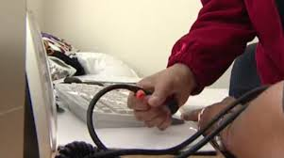
Aim for Today
Quickly go over the report
Get your input, ideas, suggestions
Notes:
My aim today is to outline what we have found in the report and to add your stories, issues, examples, views and comments into the final report, which I will complete by the end of the year.

Slide 3

What the report will cover
International Students Studying in Australia
Heath Cover for International Students
The Complexity of OSHC
Issues with OSHC
Call to Action
Notes:
Read slide
Australian Health Management (part of Medibank)
BUPA Australia
Medibank Private
Allianz Global Assistance (subcontracted by Lysaght Peoplecare)
nib OSHC
We have had questions answered by Allianz, with Medibank coming, but nothing from the others. Does anyone use them? Have a contact?
The key issues are
The gap in insurance cover between arrival, course start date and end date and visa length
Paying upfront at hospitals – hospitals viewing international students as high risk of not paying.
Obstetrics care and hospital bed shortages – priority given to medicare patients or private health care funded Australians
Emergency transport

Slide 4

So what is new?
All international students studying in Australia must have Overseas Student Health Cover (OSHC) for themselves and any dependents that accompany them.
Notes:
I know you will all be thinking we know this stuff….yes international students must have health cover and yes in the past hospitals have been a bit unclear on the rules.
But in fact it is still going on!!
Very little has changed or improved. There are still grey areas that confuse international students and hospitals are still not doing the right thing by students. Here are a few examples….

Slide 5

Its still happening
Just two weeks ago in Melbourne, Saanvi, a young female student was brought to a public hospital doubled over in excruciating pain …..
Notes:
…She was told she would not be treated without payment up front. The hospital brought the credit card payment machine to her emergency bed, but her card failed, her brother tried his credit card and it too failed. With the machine not working, the hospital finally agreed to treat Saanvi but only after her brother signed a form agreeing to be guarantor should she not pay the $550 fee.

Slide 6
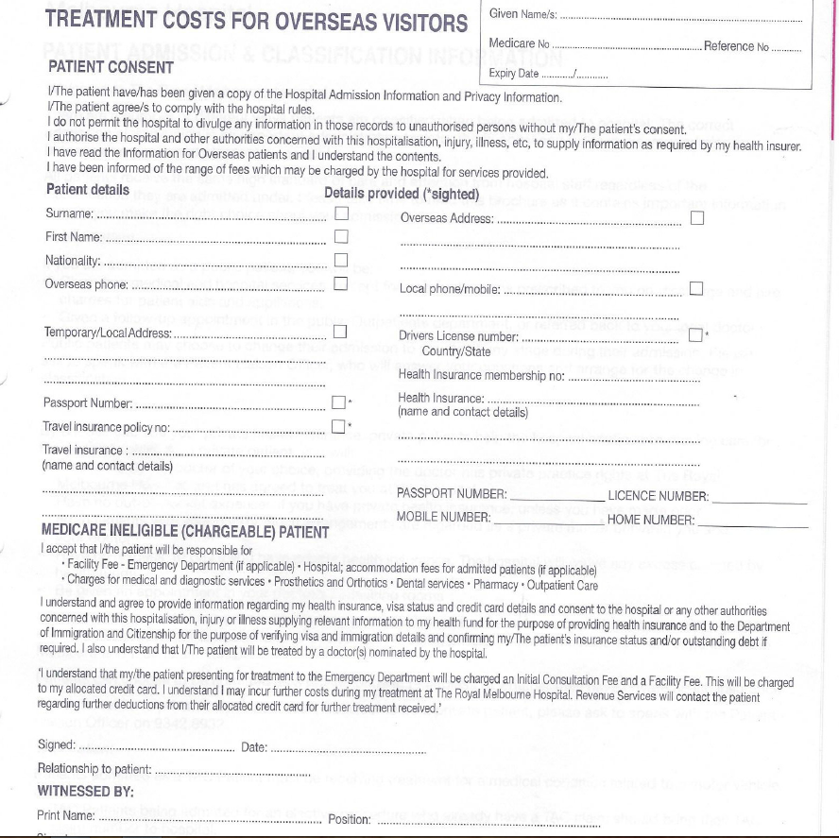
Notes:
This is the form to be signed. You see it is for tourists, really.

Slide 7
What is an emergency?
a risk of serious morbidity or mortality and requiring urgent assessment and resuscitation; or
suspected acute organ or system failure; or
an illness or injury where the viability of function of a body part or organ is acutely threatened; or
a drug overdose, toxic substance or toxin effect; or
psychiatric disturbance whereby the health of the patient or other people is at immediate risk; or
severe pain where the viability or function of a body part or organ is suspected to be acutely threatened; or
acute haemorrhaging and requiring urgent assessment and treatment; or
a condition that requires immediate admission to avoid imminent morbidity or mortality
Notes:
Seems straightforward, but it is not…here’s the definition
How can the onus be on a sick student to determine is their call for an ambulance will fall into one of these categories?
And if they call an ambulance and then feel better, they may be liable for the cost of the ambulance coming to them
Should international students pay for ambulance membership on top of their insurance? What do you think? Should we advise this? Is that the solution?

Slide 8
When is a new pain a pre-existing injury?
An AusAID student who is in Australia in 2015 through a disability program has no use of his arm after an accident 10 years ago.
A few weeks ago he felt severe pain in the arm and went to hospital….
Notes:
The hospital charged him $600 up front before they would treat him/look at him. He is now trying to put a claim through OSHC but they have said that because it was an "existing condition", he likely will not be covered.

Slide 9
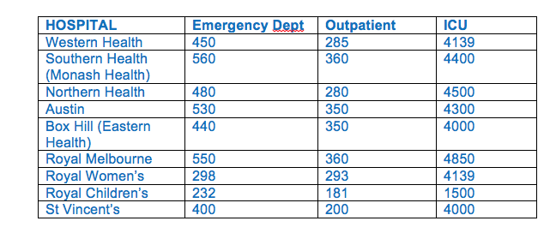
There is no Government Mandated Price
Notes:
QLD 308
ACT 488
TAS 521
NSW 126
SA 305
WA 245
NT 319
(emergency costs)
All these rates are above the medicare rebate level

Slide 10
Australian Human Rights Commission
Ensure that international students and their families have access to affordable medical and hospital treatment while studying in Australia
Ensure international students and their families have sufficient information about how to access emergency health services when required, and that health services are aware of their obligations to provide services
Support access to gender-specific health education and services and appropriate obstetrics care for international students and their partners
Notes:
Are we failing this test of fairness?

Slide 11
Any other Issues?
Pregnancy?
Deed to be Reviewed?
Visa begin and end dates/course begin and end dates?
Agents?
Others?

Slide 12
Solutions?
Education Providers to recommend Ambulance cover?
Govt guarantee to cover hospital admissions?
Note competitive advantage of other states
Education campaign for GPs, and hospital staff?
Clarification needed re: what students are covered for
Notes:
Who should be responsible for what??
Health Providers to explain our system better and compare it with the one back home?
Education Agents have commenced processing OSHC. This leads to some confusion for students as to what policy they hold and whether they can access services available on respective campuses.
Why don’t students refer to the health provider 24/7 help line if asked to pay up front?
Should DIBP suspend visa pending investigation of pre-exiting health condition??

Slide 13
Contacts
If you have anything to add to the report, please contact me
Kate Dempsey
Ph 0411 447 714
info@katedempsey.com.au
Before December 9th
Thanks

