Slide 1
Study Melbourne Student Centre

Slide 2
What we offer students
Services include:
A welcoming ‘drop-in’ place in Melbourne’s CBD
Free , confidential and face to face information and assistance
Access to services in the community through our network of well-established relationship with community, health and other service providers
Case work support students experiencing crisis or emergency (e.g. victims of crime, homelessness, mental illness, risk of breaching visa conditions)
Crisis support in emergency situations, including the provision of material aid
Information and access to other programs available from Study Melbourne including:
The Study Melbourne Internship Program
The public transport discount ticket for international students
The Study Melbourne experience

Slide 3

Early information
Connectedness
Individualised support
Notes:
Individual support – drop-in support, open, accessible, flexible to needs of individual students, culturally responsive (use of multilingual social workers, international student social work interns, interpreters, cultural support), each individual is assessed through a triage system, a decisions is made whether a more thorough assessment is required and case plan is built alongside other professionals and the student. We take a strengths based approach to the work in order to make sure that the students feels empowered to do things autonomously in the future.
Connectedness – events and activities at the Centre and off site including Ultimate Day! Use of social media channels, expansion with the new international student welfare grants initiative, new LGTBI support group, meditation, English language club
Early information – shop front with static information on rights/responsibilities, health, legal, accommodation and employment. Social media campaign calendar matched with the international student life cycle around key issues for international students. Events at the centre run by int students for int students re work, self care, settling in…

Slide 4
Data about Events & Activities
AT GLANCE
Since the launch of the SMSC in July 2014 until August 2015
Over 10,100
international students
we have engaged
470 stakeholders
we have engaged
we have organised &
participated in
191 activities & events
we have attended
98 outreach activities

Slide 5
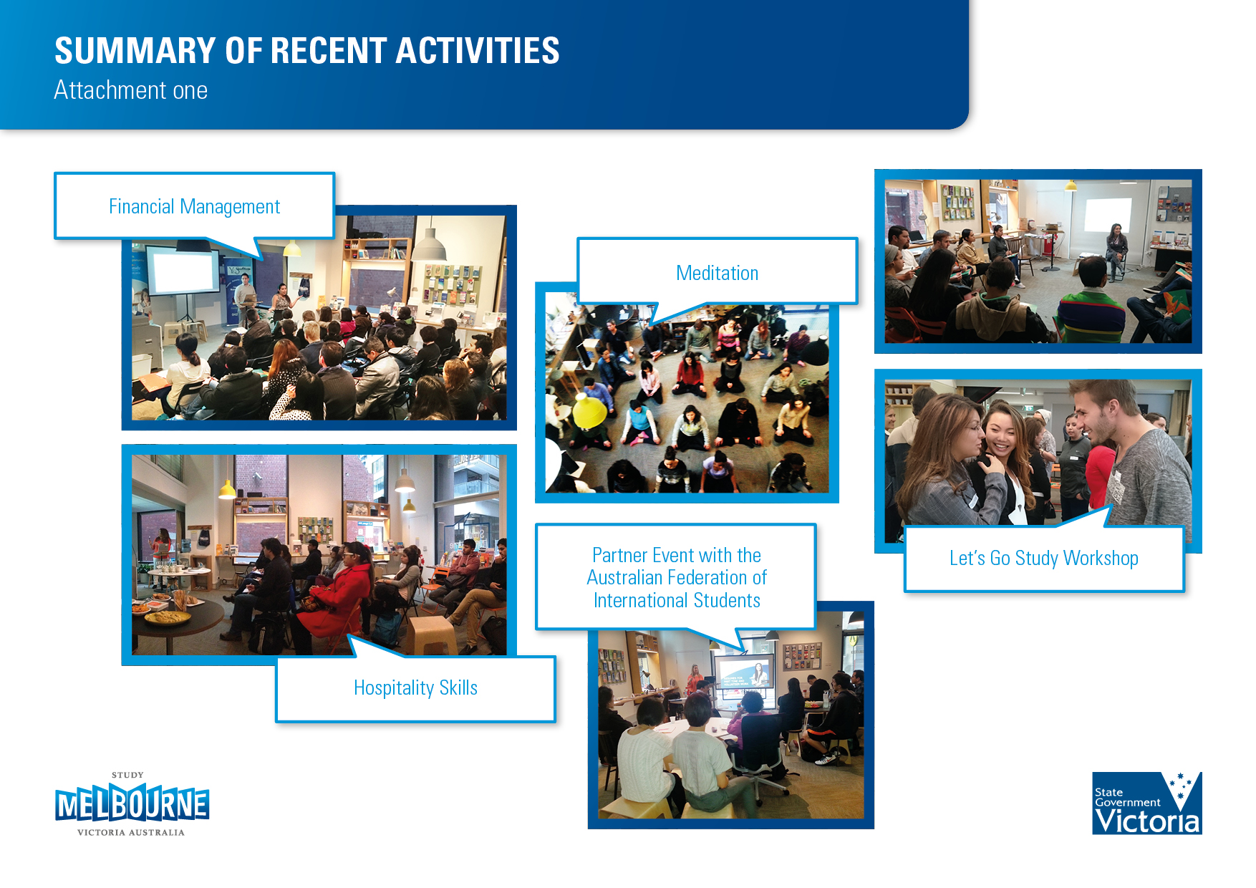

Events & Activities

Slide 6
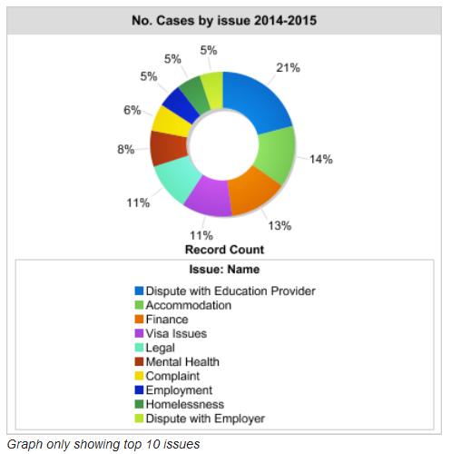
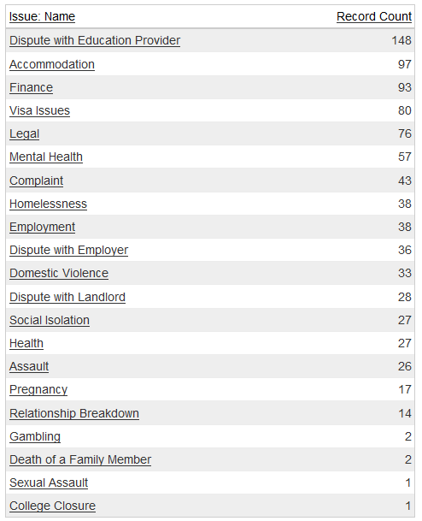
Data for Casework
From January 2014 to September 2015

Slide 7
Mental health and wellbeing for international students
Mental health is 6th top issue for international students requiring casework support – has remained consistent since 2010.
Issues in two main categories – stress and emotional related issues impacting functioning, and more serious issues like anxiety, depression, psychosis.
International students with mental health often present with other issues including accommodation, financial and academic issues.
High risk group due to age, unfamiliarity with culture and services, away from supports, mixed living skills/poor stress management, family pressure/expectations.

Slide 8
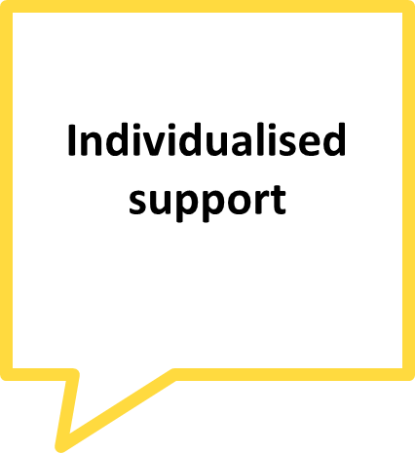
Recommended approach
Referrals to a ‘good’ GP – rule out physical issues and identify co-existing issues such as substance use
Referrals to private psychologists with language capabilities
Acute – CAT, YAT and emergency departments
Headspace and other community mental health services
Online and telephone support

Slide 9

Recommended approach
Static information in your offices and where students meet
Train staff/student leaders to identify symptoms early and be proactive
Run workshops on self care, managing stress, healthy relationships, healthy eating

Slide 10

Recommended approach
Social media engagement – peer-to-peer support
Community engagement activities
Sports/recreational activities
Volunteering

Slide 11
Resources
For staff
Victorian Transcultural Mental Health (VTMH) – training and secondary consultation
http://www.vtmh.org.au/
Orygen Youth Health training and consultation
http://oyh.org.au/training-resources/training-our-local-community-sector
Mental Health First Aid training
https://mhfa.com.au/
Spectrum – personality disorder training and consultation
http://www.spectrumbpd.com.au/pages/professional-development.php
Victorian Dual Disability Service - co-existing mental health with intellectual disability issues
http://www.svhm.org.au/services/VictorianDualDisabilityService/Pages/VictorianDualDisabilityService.aspx
Living Works- Applied Suicide Intervention Skills Training (ASIST)
https://www.livingworks.net/programs/asist/
Turning Point- co-existing mental health with alcohol and other drugs issues
http://www.turningpoint.org.au/Education/Professional-Development.aspx

Slide 12
Resources
For students
Online
Youth Beyond Blue- info & online chat https://www.youthbeyondblue.com/home
ReachOut- info & resources http://au.reachout.com/
Bite Back- wellbeing & mental fitness resources http://www.biteback.org.au/
It’s all right- factsheets & personal stories http://www.itsallright.org/
Telephone
Lifeline- 13 11 14
Kids Helpline- 1800 55 1800 (up to 25 years old)
Beyond Blue- 1300 22 4636
In Person
Headspace- http://headspace.org.au/headspace-centres/

