Slide 1
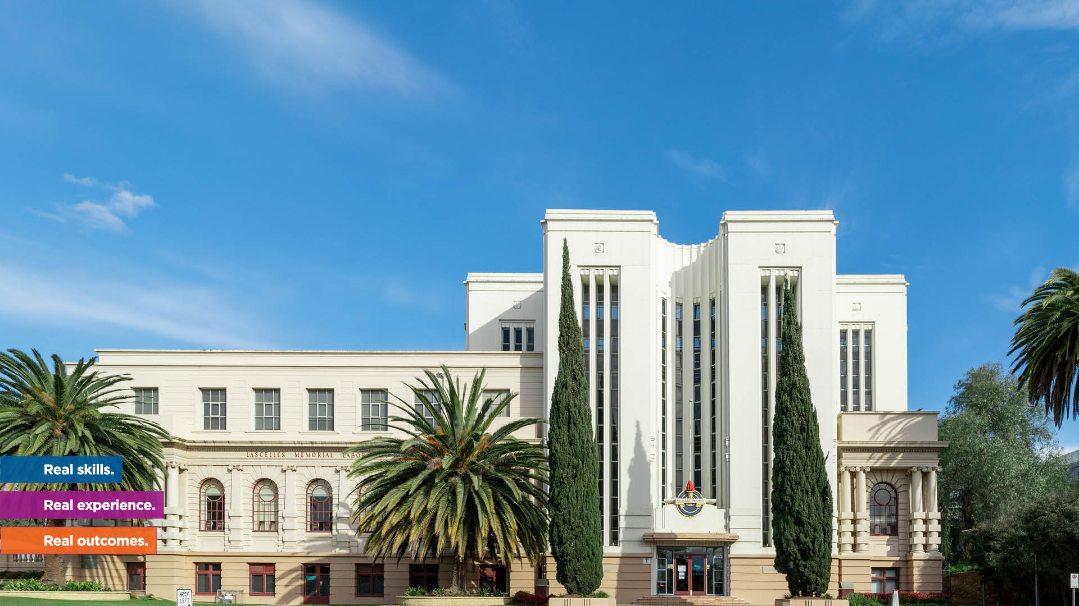

Making a difference for International Students
Presented by:
Katrina Bye

Slide 2
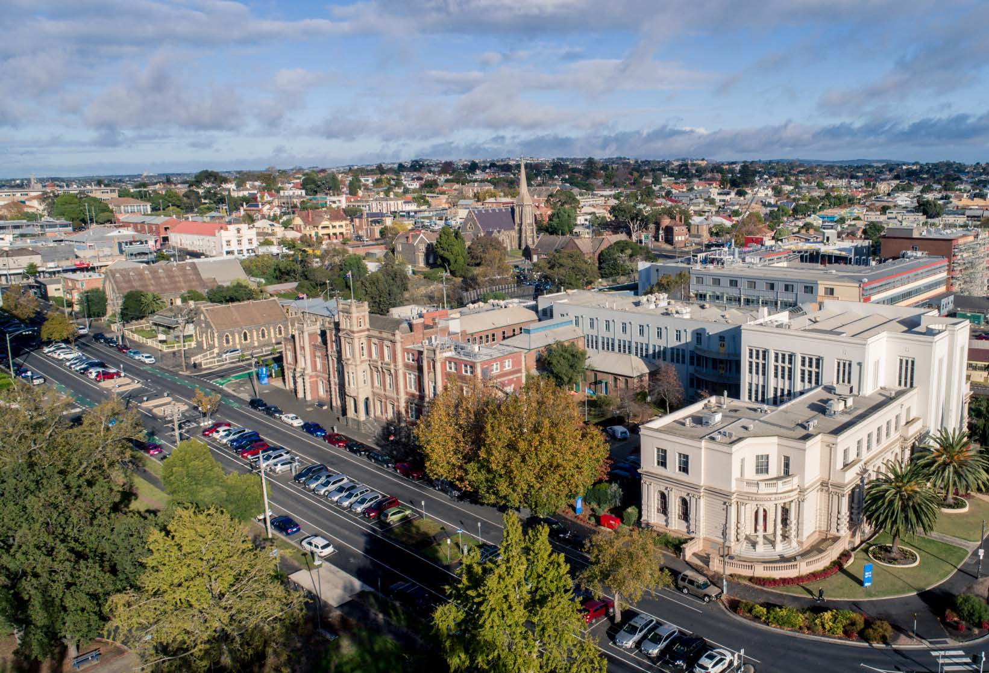

About The Gordon
Over 130 years of world-class vocational education
Quality education in a regional location
Less theory and more hands-on training
Industry connections lead to employment
Real work experience gives job-ready skills
Real skills. Real experienc
thegordon.edu.au/internatio
e. Real outcomes.
nal CRICOS Provider No. 00011G TAFE 3044

Slide 3

Student Support Services
Customer Service
& Student Hub
International
Office
Orientation
24/7 Learning
Support
Libraries
Personal
Counselling
Career
Counselling &
Skill and Job
Centre
Free Wi-Fi & Free
Office 365
Airport Pick-up
Service
Real skills. Real experience. Real outcomes.
thegordon.edu.au/international
CRICOS Provider No. 00011G TAFE 3044

Slide 4
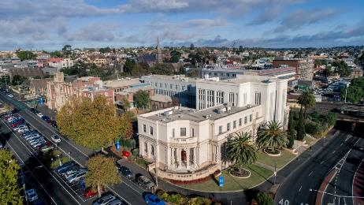
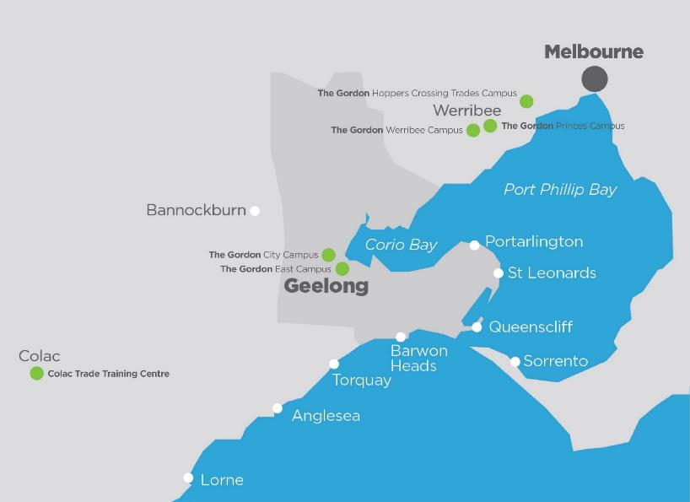
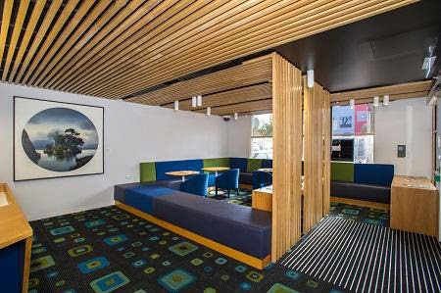
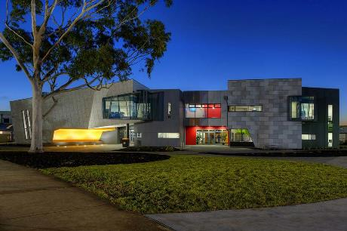
Campuses
The Gordon has two major campuses in Geelong, the second largest city in the state of Victoria, located 75 km south-west of Melbourne. The Gordon has also Werribee and Hoppers Crossing campuses, in the fast growing Wyndham region.
Geelong City Campus
Werribee Campus
East Geelong Campus
Real skills. Real experience. Real outcomes.
thegordon.edu.au/international
CRICOS Provider No. 00011G TAFE 3044

Slide 5


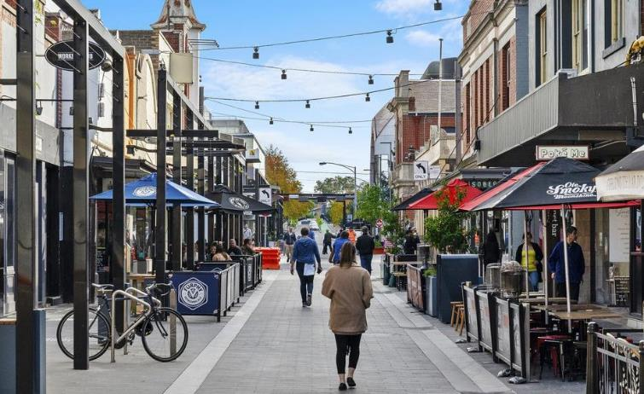
About Geelong
Real skills. Real experience. Real outcomes.
thegordon.edu.au/international
CRICOS Provider No. 00011G
TAFE 3044

Slide 6
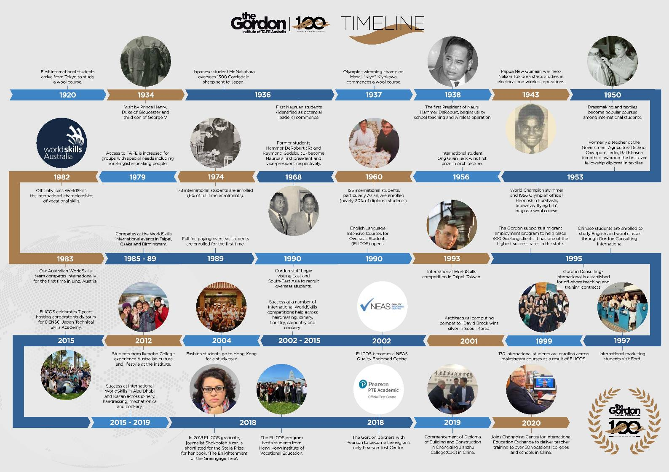

Slide 7

George Zhang
International Business Development Manager (Greater China)
Our Team
Lavender Kwan
International and Commercial Senior Officer
Lana Guo
International Student Liaison and Admissions Officer
Xuan Liu
International Admissions and Recruitment Officer
Jana Perera
Executive Director of Commercial Business
Katrina Bye
Manager Commercial Operations and International
Ally Scale
International Team Leader
Real skills. Real experience. Real outcomes.
thegordon.edu.au/international CRICOS Provider No. 00011G TAFE 3044

Slide 8


Purpose and Vision
To provide a personalised experience
To make a difference
Real skills. Real experience. Real outcomes.
thegordon.edu.au/international CRICOS Provider No. 00011G TAFE 3044

Slide 9
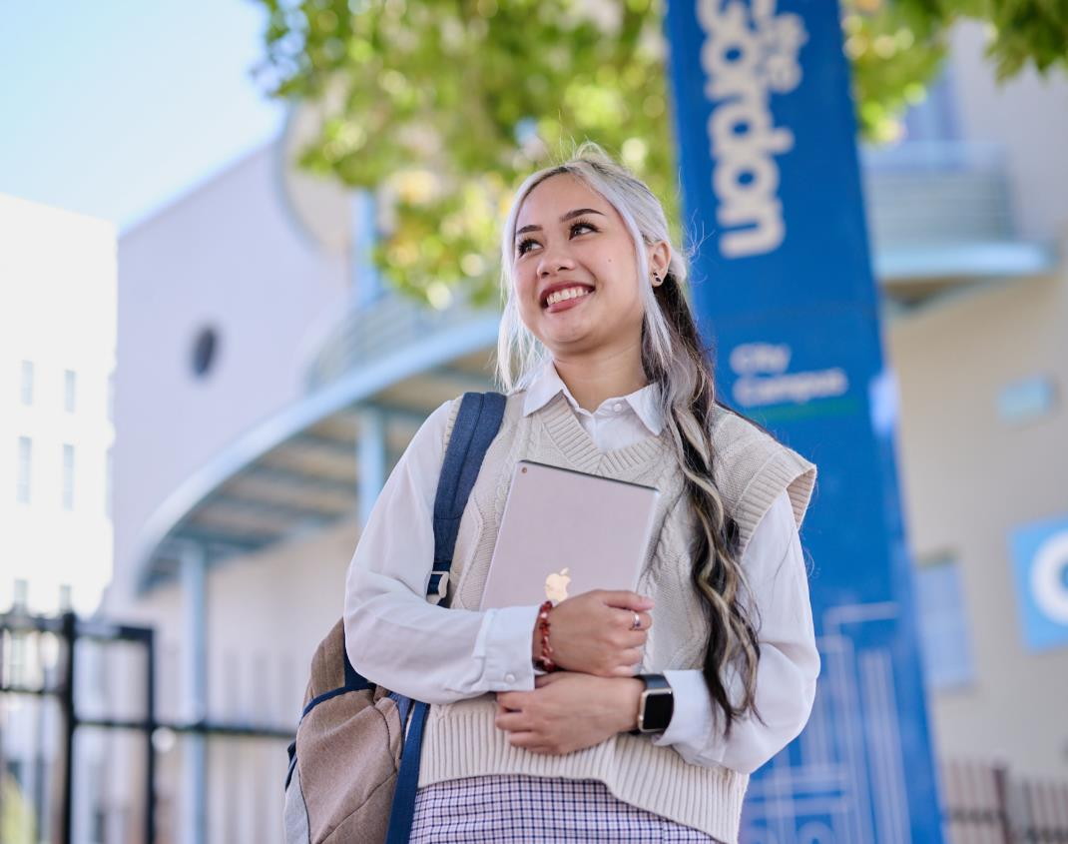
Our Students
Students over the yearsat The Gordon come from 107 different countries and represent 78 nationalities.
We are proud of and value the diversity that everyone brings to our campuses.
Real skills. Real experience. Real outcomes.
thegordon.edu.au/international CRICOS Provider No. 00011G TAFE 3044

Slide 10

Our Students

Slide 11

TRIPLE WINNER 2021-22 Victorian International Education Awards!
  Premier's Award for Victorian International Education Provider of the Year
  Excellence in International Education - TAFE
  Excellence in International Student Experience

Slide 12


Slide 13


What we did
Enhanced the experience of international students through:
Communication
Support
Engagement and Integration with Community
Excellence in delivery of service
Real skills. Real experience. Real outcomes.
thegordon.edu.au/international CRICOS Provider No. 00011G TAFE 3044

Slide 14

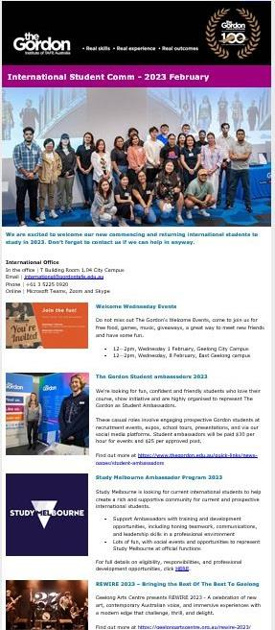
Communication
Priority Focus
Tailored communication to address student needs
We asked the students what they needed and followed their lead
We revied and refined
Real skills. Real experience. Real outcomes.
thegordon.edu.au/international CRICOS Provider No. 00011G TAFE 3044

Slide 15


Support
Counselling Services
International Student Sessions
Food Relief
External Support Services
Learning Needs
Housing advice
Employment Partnerships
Real skills. Real experience. Real outcomes.
thegordon.edu.au/international CRICOS Provider No. 00011G TAFE 3044

Slide 16

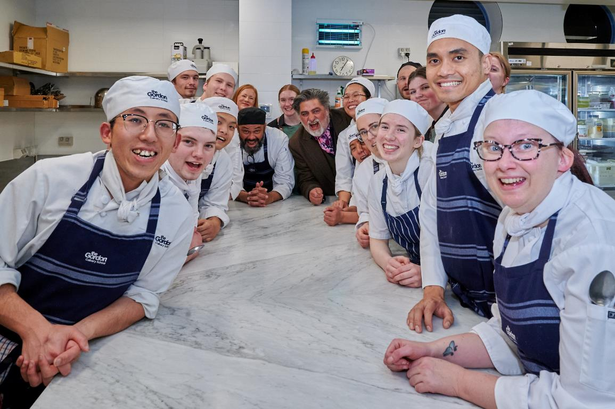
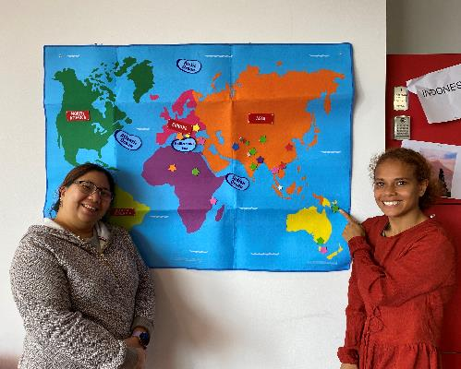
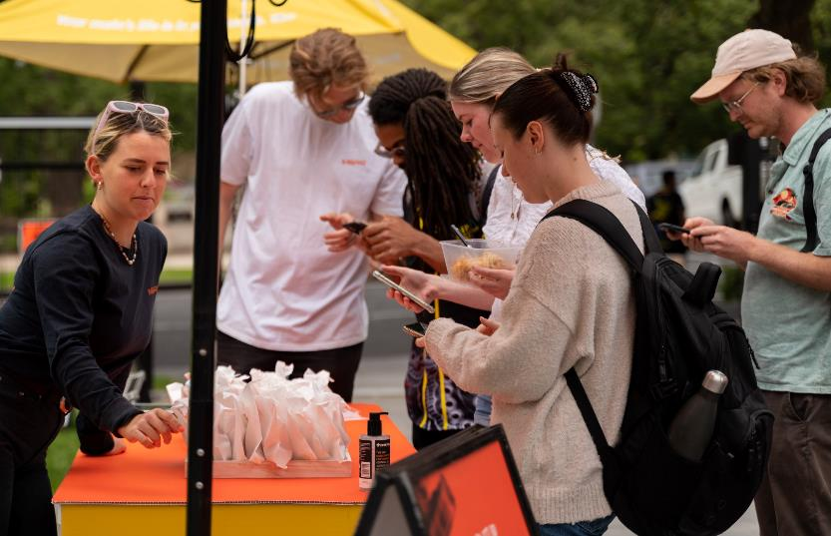
Community
Key relationships
Internal and external
Social activities
Alumni connection
Local activities
Connectors
Real skills. Real experience. Real outcomes.
thegordon.edu.au/international CRICOS Provider No. 00011G TAFE 3044

Slide 17
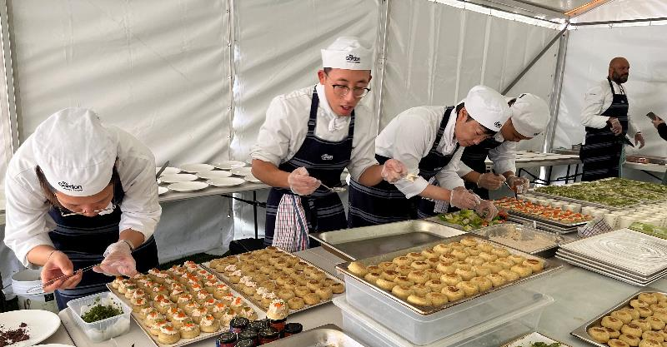
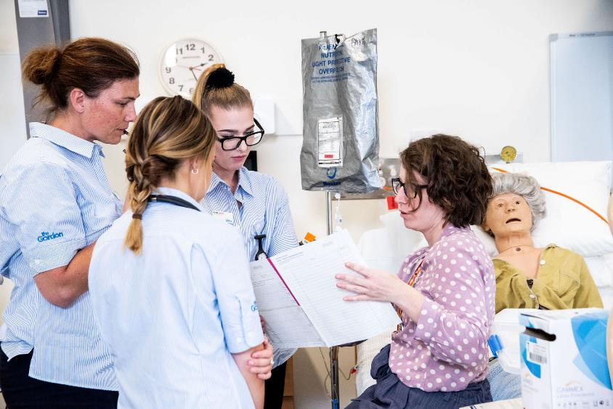
Service Excellence
Students First
Personalised Service
Practical and Hands on
Teacher importance
Student led
Student Feedback
Real skills. Real experience. Real outcomes.
thegordon.edu.au/international CRICOS Provider No. 00011G TAFE 3044

Slide 18
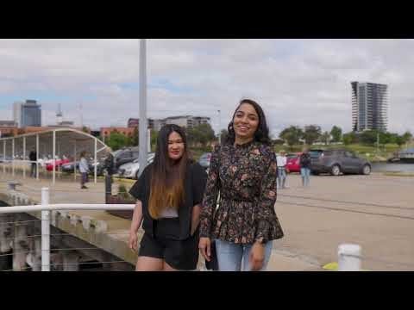

Slide 19



